Slide 1



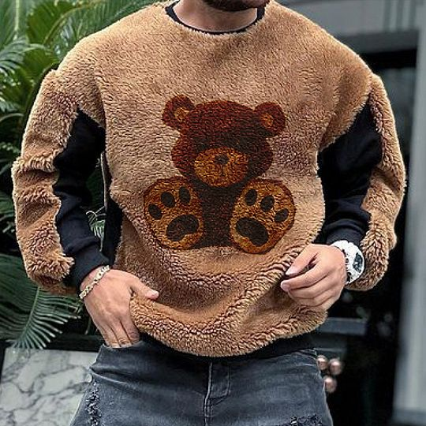
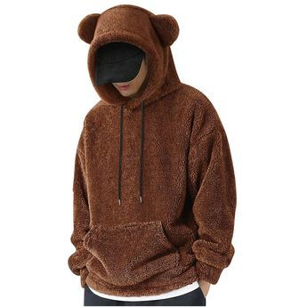

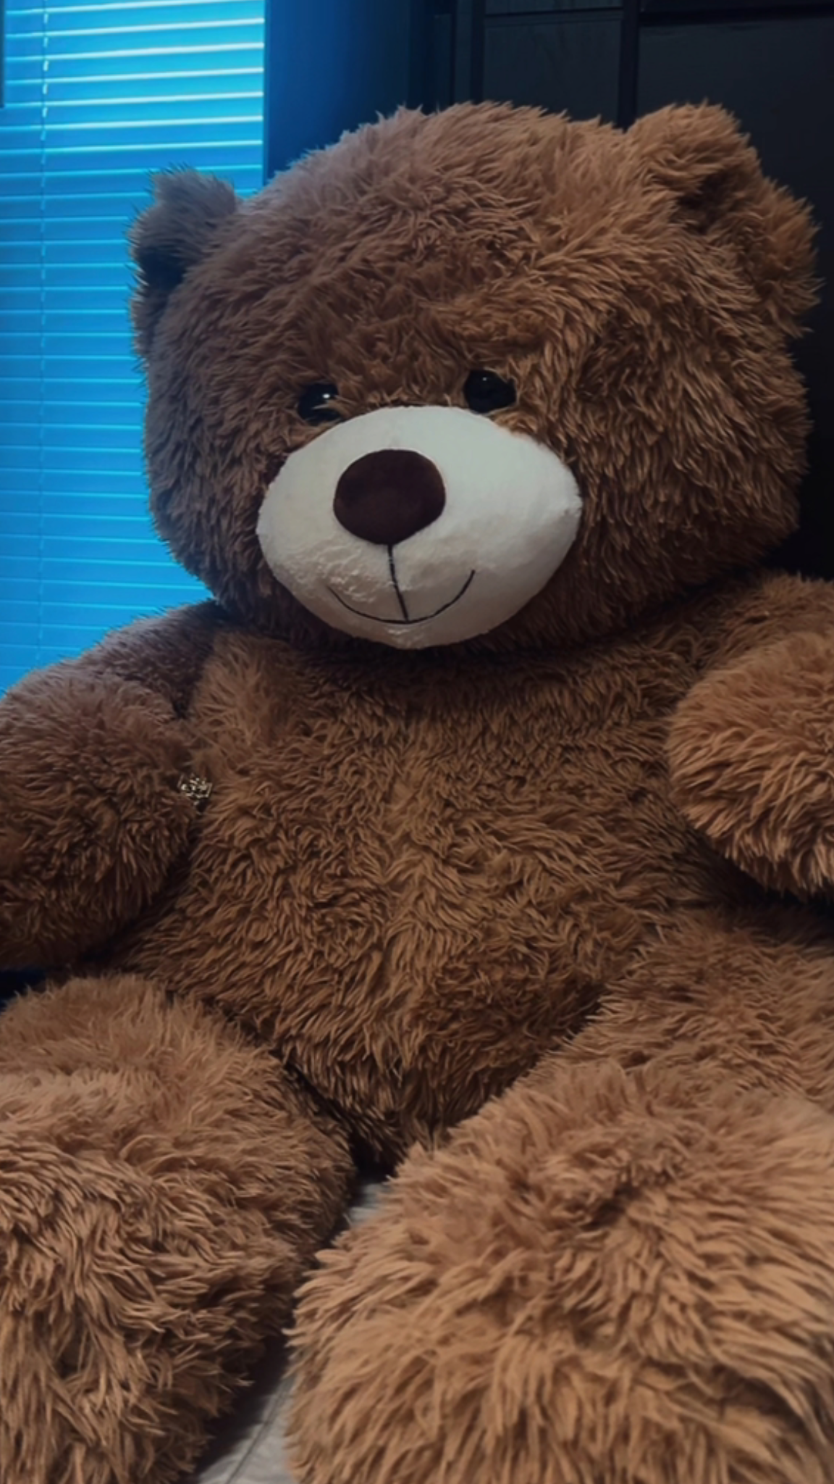


Brian Elmwood
Care Bear

Slide 2
Character Name
Character Checklist
Goal | Why do they do, what they do | A specific personality / Universal Behaviour | What makes them different
Flaw | something negative about them | Secrets | Something mysterious about them (can be silly)
Belonging | Which group do they belong too | Assertiveness | How does he present himself
Believe | In what do they believe | Specific Tastes and professions | What do they prefer
Information | How does he enrich the world | Hurt Them | The most hurtful situation
Special Skill | Give them a cool but very dumb quirk

Slide 3
Character Name
Character Bio (short)
Name:
Gender:
Age:
Personality:
Alignment:
Occupation:
Describe the past, the what and the now shortly

Slide 4
Character Name
Character Bio (Long)
Describe the past, the what and the now (see the checklist)

Slide 5
Weapons
Weapon -
Detailed Description:

Slide 6
Attacks & Abillities
- Attack/Abillity -
- Attack/Abillity -
- Attack/Abillity -
-
-
-
- Attack/Abillity -
- Attack/Abillity -
- Attack/Abillity -
-
-
-

Slide 7
Character: (Name) | DIALOGUE BARK – Situation v01 | DIALOGUE BARK – Situation v02
Location/Action
Location/Action
Location/Action
Location/Action
Location/Action
Location/Action
Character: (Name) | DIALOGUE BARK – Situation v01 | DIALOGUE BARK – Situation v02
Location/Action
Location/Action
Location/Action
Location/Action
Location/Action
Location/Action
Character: (Name) | DIALOGUE BARK – Situation v01 | DIALOGUE BARK – Situation v02
Location/Action
Location/Action
Location/Action
Location/Action
Location/Action
Location/Action
Notes:
20 minutes
Remember, when you are done your first draft. YOU ARE NOT DONE. COUNT YOUR WORDS, if you are over 20 or under 3 in any line of dialogue you must edit your own text to make it fit or expand on the world lore or to make the character speaking sound unique.

Slide 8
Character: (Name) | DIALOGUE BARK – Situation v01 | DIALOGUE BARK – Situation v02
Location/Action
Location/Action
Location/Action
Location/Action
Location/Action
Location/Action
Character: (Name) | DIALOGUE BARK – Situation v01 | DIALOGUE BARK – Situation v02
Location/Action
Location/Action
Location/Action
Location/Action
Location/Action
Location/Action
Character: (Name) | DIALOGUE BARK – Situation v01 | DIALOGUE BARK – Situation v02
Location/Action
Location/Action
Location/Action
Location/Action
Location/Action
Location/Action
Notes:
20 minutes
Remember, when you are done your first draft. YOU ARE NOT DONE. COUNT YOUR WORDS, if you are over 20 or under 3 in any line of dialogue you must edit your own text to make it fit or expand on the world lore or to make the character speaking sound unique.

